Slide 1
Alma Collaborative Network and Shared Catalog for Network Zone Consortia
Yoel Kortick
Senior Librarian

Slide 2
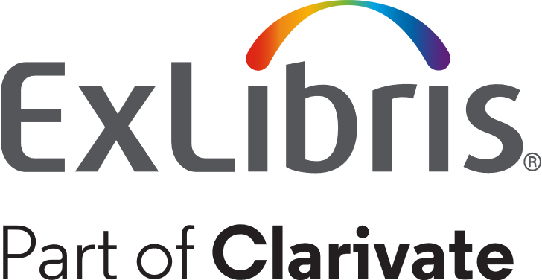
Agenda
Introduction
Repository search in Member Institution and Network Zone
Linking from Network Zone to My Institution
Linking a record from the Member Institution to the Network Zone.
Primo search in Member Institution and Network Zone - configuration
Primo search in Member Institution and Network Zone - example

Slide 3
Introduction

Slide 4
Introduction
Alma supports data sharing and collaboration across institutions in a streamlined manner.
The Alma Network Zone (NZ) enables bibliographic data to be shared between collaborating institutions of the same Network Zone Consortia for cataloging and inventory purposes.
As part of the NZ, a Network tab appears as part of the Repository Search. Using this tab, collaborating institutions can search for resources within their shared network.

Slide 5
Introduction
The collaboration among the members of the consortia is not only related to bibliographic data but also to other aspects of library management such as
  Acquisitions
  Management of electronic resources
  Resource sharing
  Fulfillment and sharing of patrons

Slide 6
Introduction
This presentation will focus on the Shared Catalog in the framework of a Network Zone Consortia
Members of a Shared Catalog in the framework of a Network Zone Consortia are working together by managing a shared catalog in Alma to describe their institutional holdings
The shared catalog is a way to maximize cooperation, integration and sharing between institutions in a network
It still allows institutions to maintain local privacy and ownership of data

Slide 7
Introduction
In the example here we have a network zone and three member institutions:
Member / Network | Name | Inst. Code
Network | Ex Libris University Consortium | EXLDEMO2_INST
Member | Alma University | EXLDEV1_INST
Member | Open University | EXLDEMO3_INST
Member | University of Knowledge | EXLDEMO1_INST

Slide 8

Introduction
Network Zone
Ex Libris University Consortium
Member Institution
Alma University
Member Institution
Open University
Member Institution
University of Knowledge

Slide 9
Repository search in Member Institution and Network Zone

Slide 10
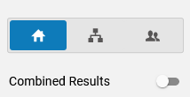

Repository search in Member Institution and Network Zone
In the following examples we will look at the "Institution" tab and the "Network" tab.
The "Network" tab only appears for institutions which are members of a Network Zone Consortia.
Part of a Network Zone Consortia | Not Part of a Network Zone Consortia

Slide 11
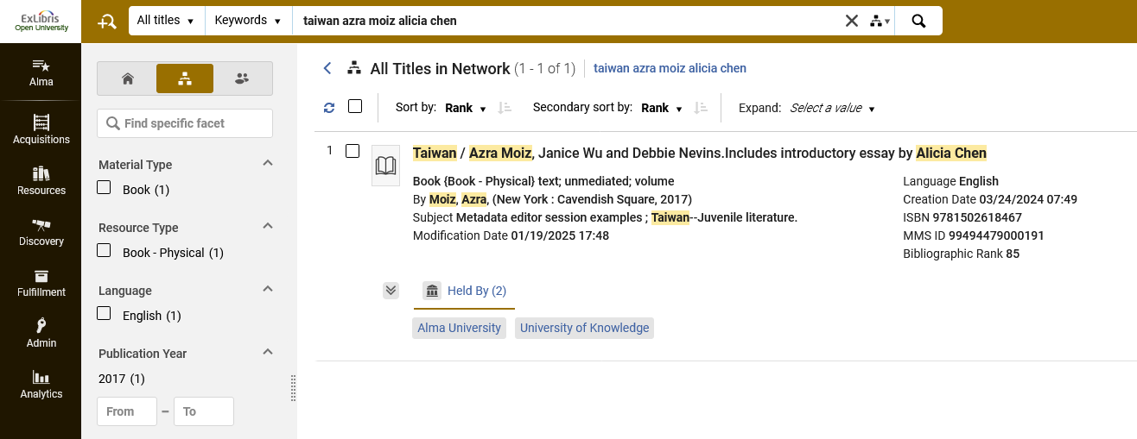
Repository search in Member Institution and Network Zone
Here is a an all titles search done by member institution "Open University" for records with "Taiwan" in the title.
The search is done in the "Network" scope.

Slide 12
Repository search in Member Institution and Network Zone
The results then show which consortia member intuitions have inventory for the record. This is in the "Held By" tab.
Here is title "Taiwan / Azra Moiz, Janice Wu and Debbie Nevins. Includes introductory essay by Alicia Chen"
This resource is held by two institutions:
Alma University
University of Knowledge

Slide 13
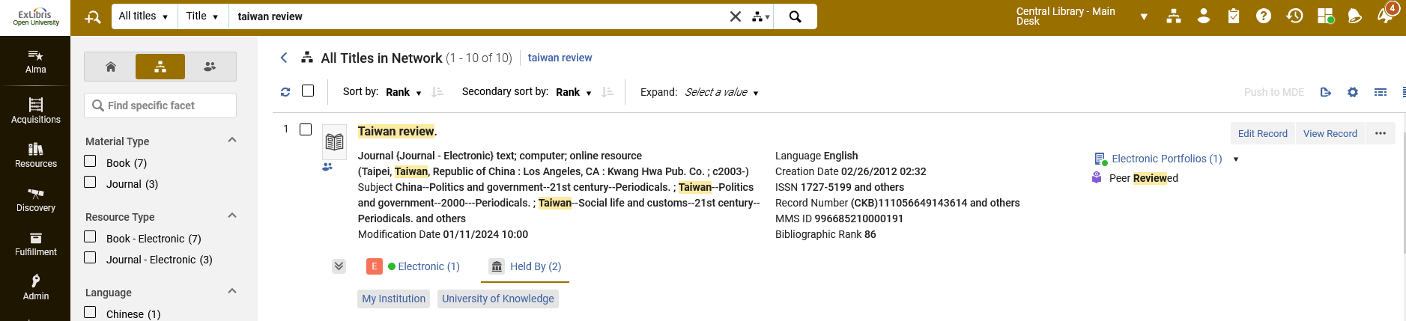
Repository search in Member Institution and Network Zone
Here is title "Taiwan Review"
This resource is held by two institutions:
My Institution (Open University)
University of Knowledge

Slide 14
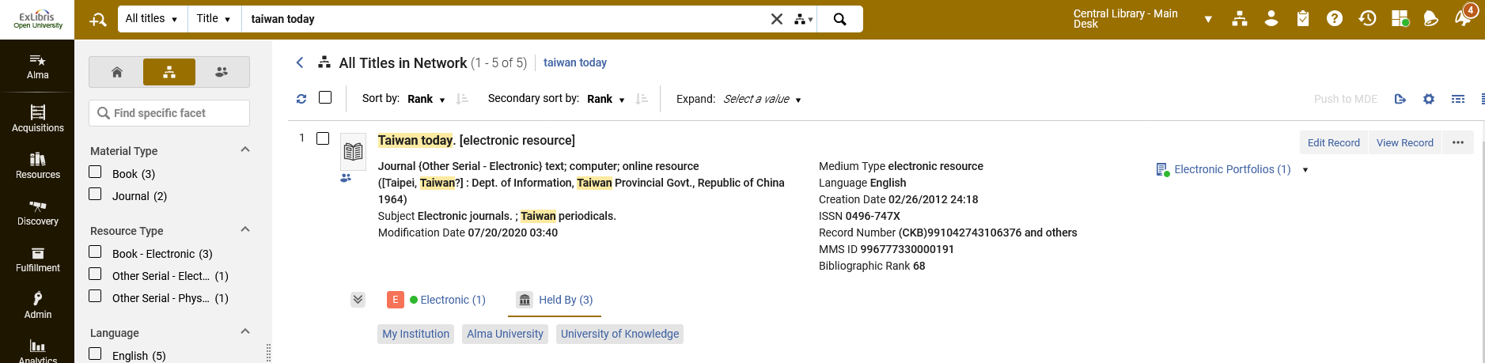
Repository search in Member Institution and Network Zone
Here is title "Taiwan Today"
This resource is held by all three institutions:
My Institution (Open University)
Alma University
University of Knowledge

Slide 15
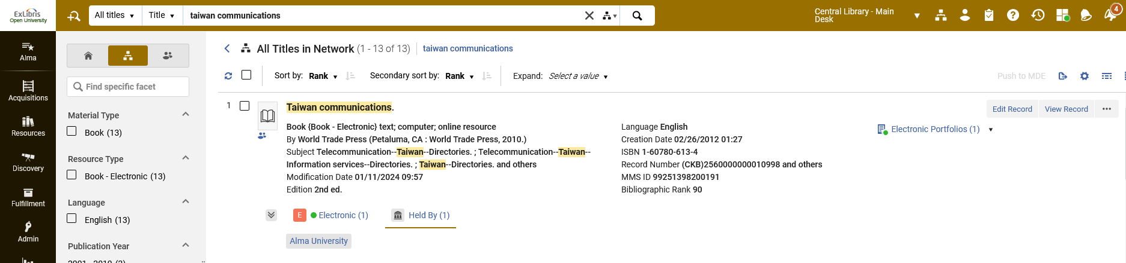
Repository search in Member Institution and Network Zone
Here is title "Taiwan communications"
This resource is held by one institution:
Alma University

Slide 16
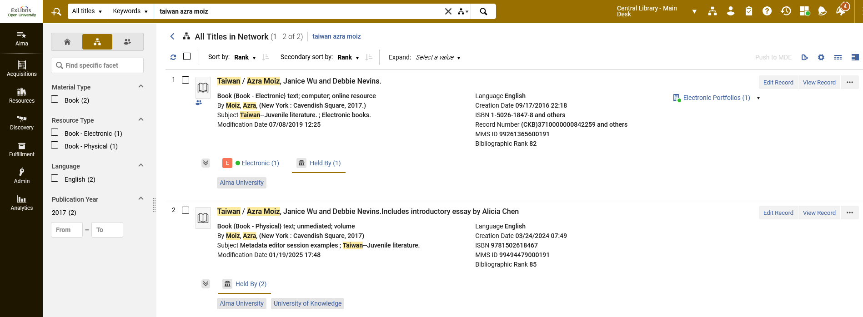
Repository search in Member Institution and Network Zone
Clicking the “Institution Name" link provides details of the inventory in holding institution
We are still searching the Network Zone scope from member institution "Open University.
Member institution "Alma University" has inventory for this record
Member institutions "Alma University" and "University of Knowledge" have inventory for this record

Slide 17
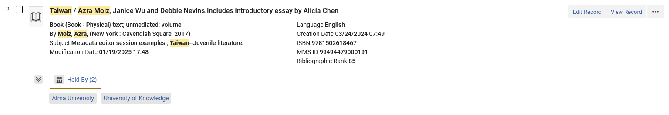
Repository search in Member Institution and Network Zone
While still searching the Network Zone scope from member institution "Open University" we will click "University of Knowledge" to get details of the inventory at "University of Knowledge"

Slide 18
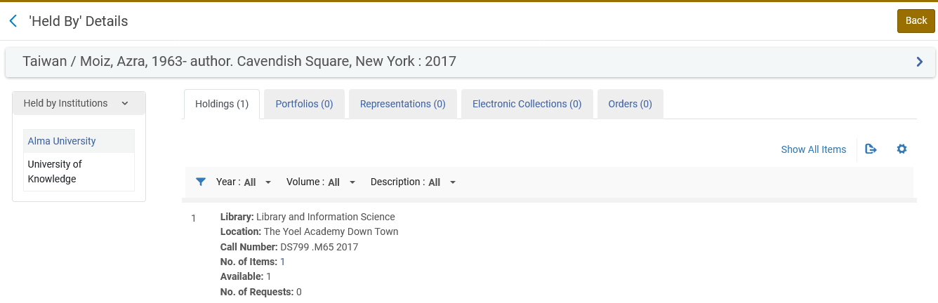
Repository search in Member Institution and Network Zone
We now see details of the physical inventory at "University of Knowledge". We know it is physical inventory because it is in a "Holdings" tab.
We also see that for this record there is no inventory of other types
We also see which other institutions have inventory for this record and can click the link to the institution for details

Slide 19
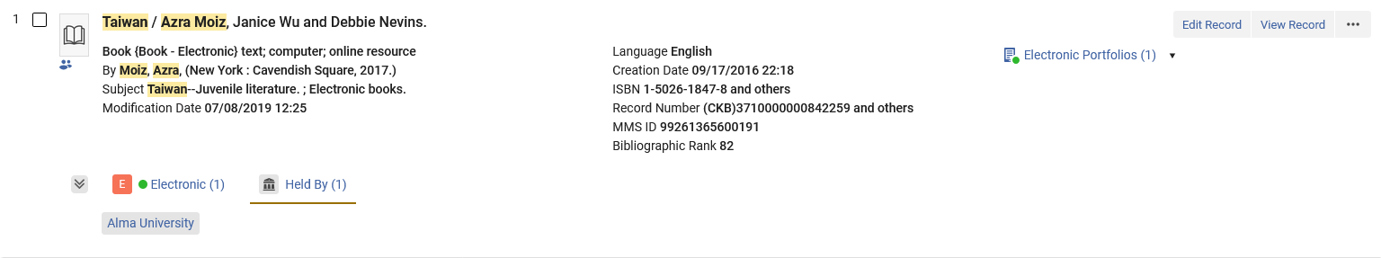
Repository search in Member Institution and Network Zone
While still searching the Network Zone scope from member institution "Open University" we will click "Alma University" to get details of the inventory at "Alma University"

Slide 20
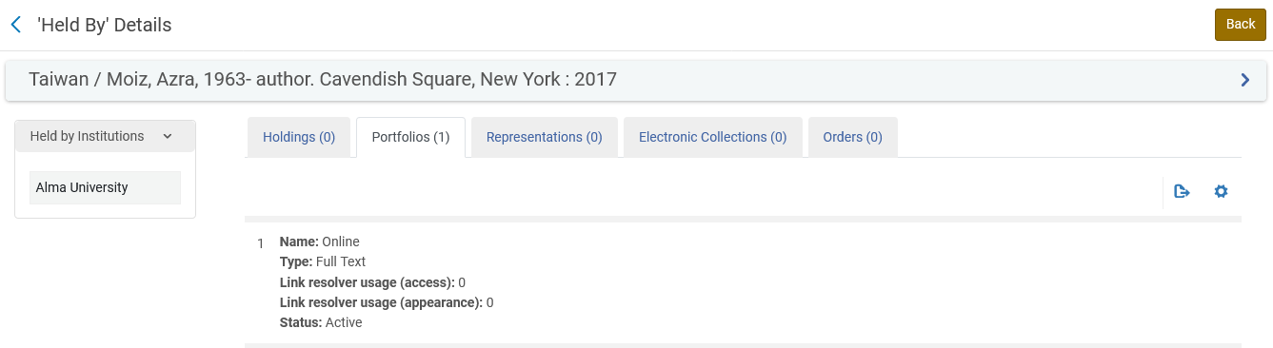
Repository search in Member Institution and Network Zone
We now see details of the inventory at "Alma". We know it is electronic inventory because it is in a "Portfolios" tab.

Slide 21
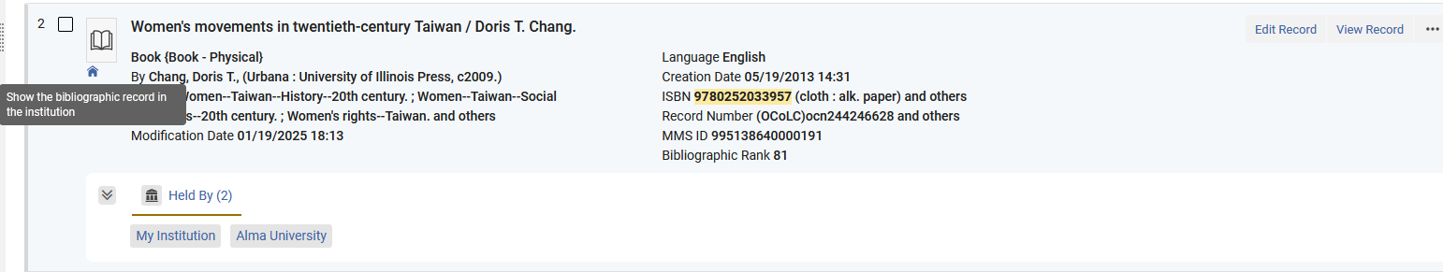
Repository search in Member Institution and Network Zone
Note also the “Show the bibliographic record in the institution" icon.
This icon is displayed in the Network tab if the record is linked to the Member Institution which is searching the Network Zone scope.
We are still searching the Network Zone scope from member institution "Open University“, searching for all titles ISBN 9780252033957

Slide 22
Repository search in Member Institution and Network Zone
The reason that the "Show the bibliographic record in the institution" icon appears is because:
It is "held by" Member Institution "Open University".
We are still searching the Network Zone scope from member institution "Open University"

Slide 23
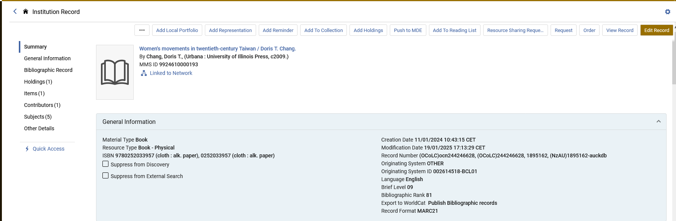
Repository search in Member Institution and Network Zone
After clicking the "Show the bibliographic record in the institution" icon we are brought to the Institution Zone scope and we can view record details
Then we have an icon "Show the bibliographic record in the network"

Slide 24
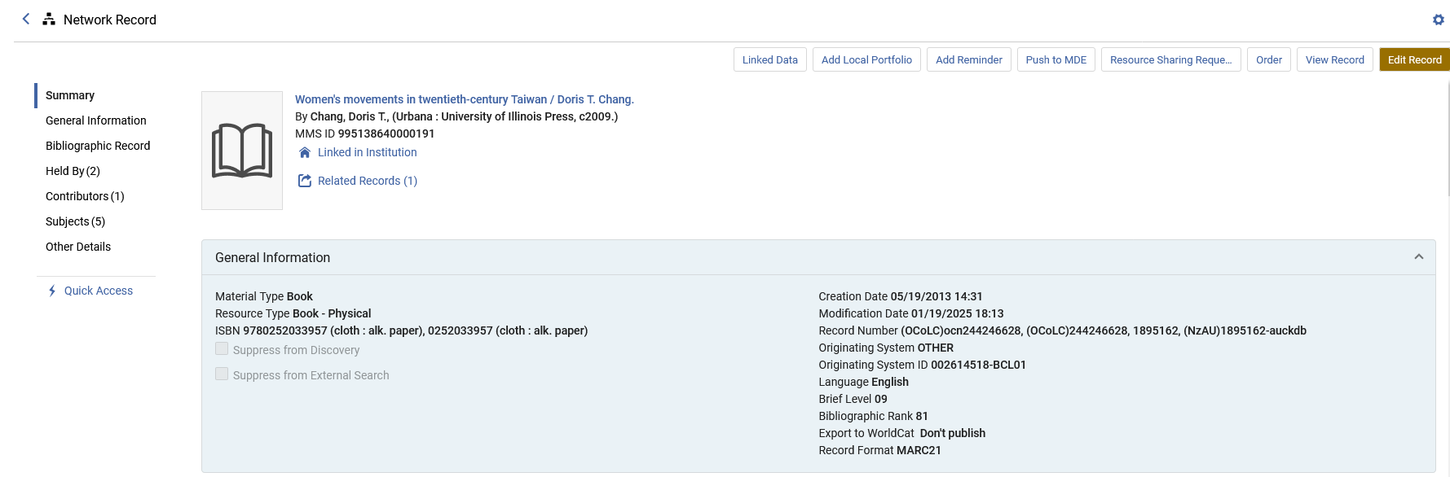
Repository search in Member Institution and Network Zone
After clicking the " Show the bibliographic record in the network" icon we are brought to the "Network Zone" search scope with the record retrieved.

Slide 25
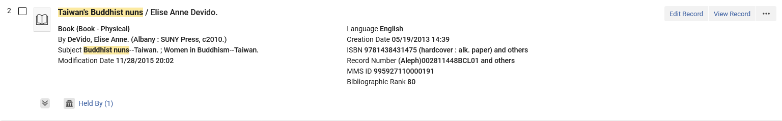
Repository search in Member Institution and Network Zone
This record does not have a " Show the bibliographic record in the institution" icon when searching the network zone search scope from member institution “Open University”.
No icon

Slide 26
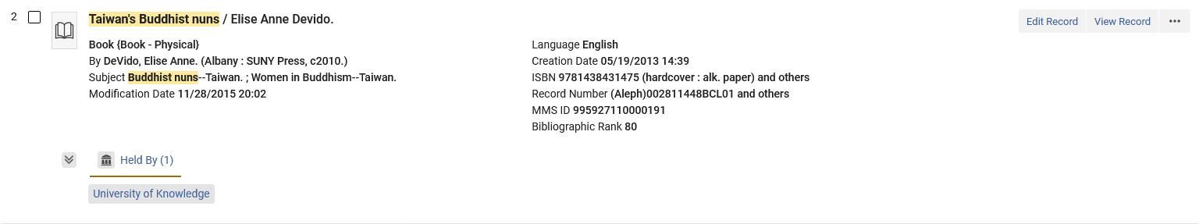
Repository search in Member Institution and Network Zone
It does not have a "Show the bibliographic record in the institution" icon because it is not held by "My Institution" (Member Institution "Open University")
Not held by My Institution

Slide 27
Linking from Network Zone to My Institution

Slide 28
Linking from Network Zone to My Institution
We will now show that if there is a bibliographic record in the network zone and we do not have inventory for this bibliographic record in our member institution then we can
Search for and find the record in the network zone and then either
  Click "Catalog" and then from the metadata editor add inventory
  Click "Order" and then create a POL which includes inventory
The bibliographic record in the network zone will then appear with "Held By" and "My Institution".
It is also possible to link from the Network Zone to the Member Institution without adding inventory.

Slide 29
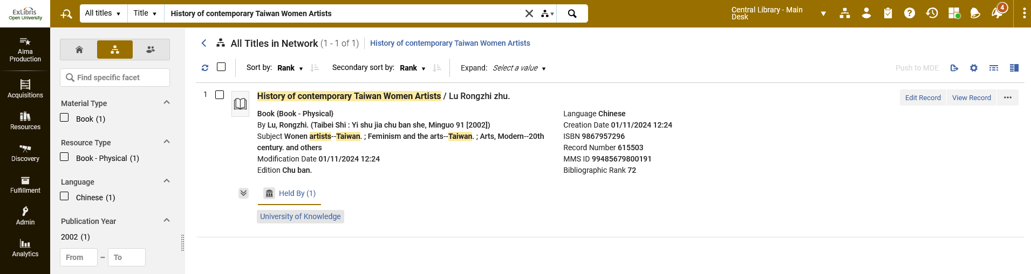
Linking from Network Zone to My Institution
Title "History of contemporary Taiwan Women Artists" does not have inventory in my institution.
We are still searching the network scope from member institution "Open University".

Slide 30

Linking from Network Zone to My Institution
We can add inventory in our Member Institution for this record by clicking "edit" and then adding inventory in the metadata editor.
We can also add inventory in our Member Institution by clicking "order"
We will click "Edit Record"

Slide 31
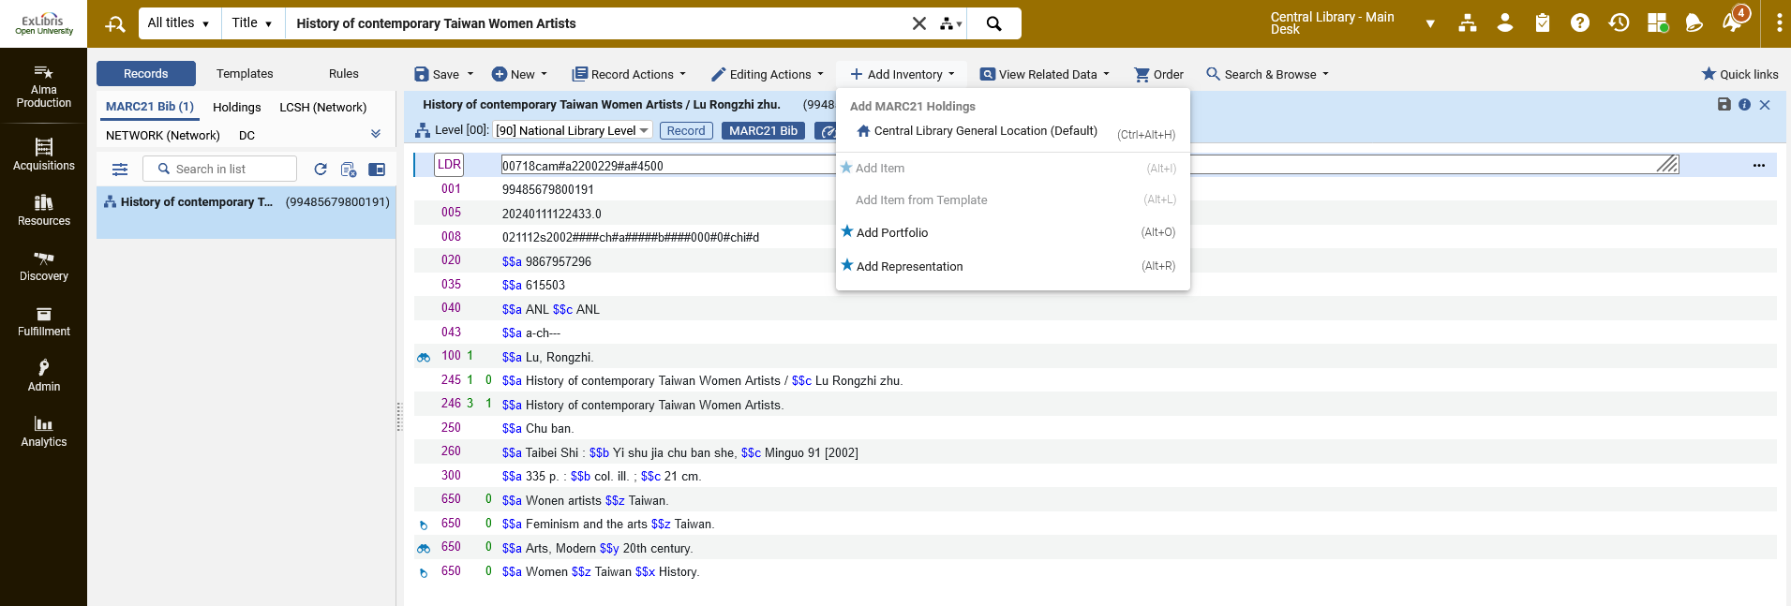
Linking from Network Zone to My Institution
The record opens in the metadata editor, and we will add inventory

Slide 32
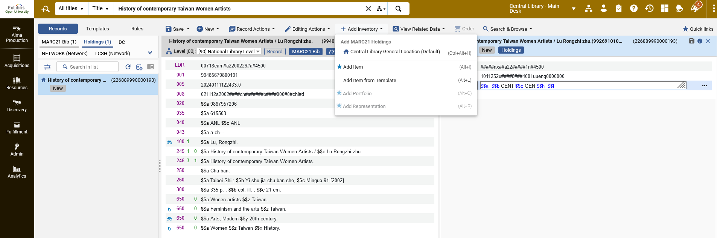
Linking from Network Zone to My Institution
We added a holdings record and now we will add an item

Slide 33

Linking from Network Zone to My Institution
Now title "History of contemporary Taiwan Women Artists" does have inventory in "My institution".
Icon “Show the bibliographic record in the institution”

Slide 34
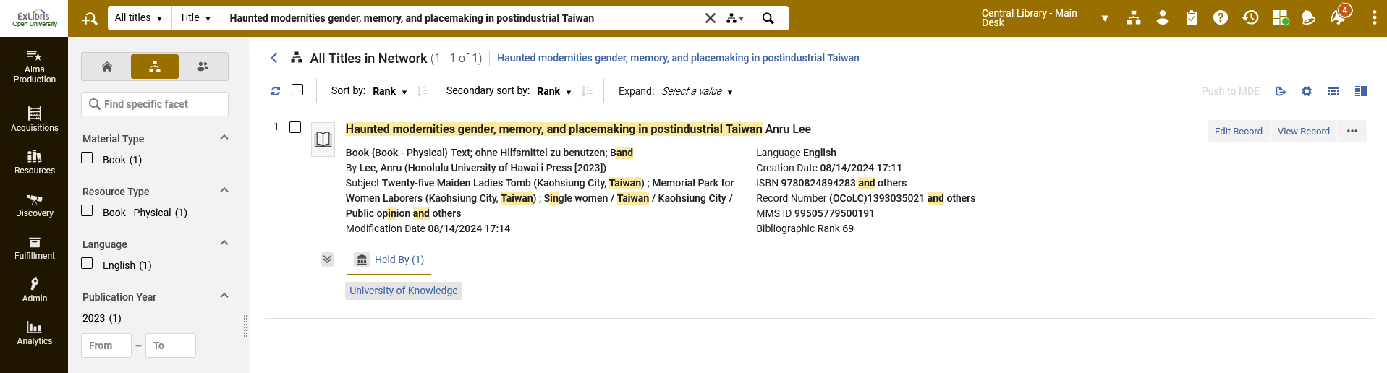
Linking from Network Zone to My Institution
Title "Haunted modernities gender, memory, and placemaking in postindustrial Taiwan" does not have inventory in my institution.
We are still searching the network scope from member institution "Open University".

Slide 35
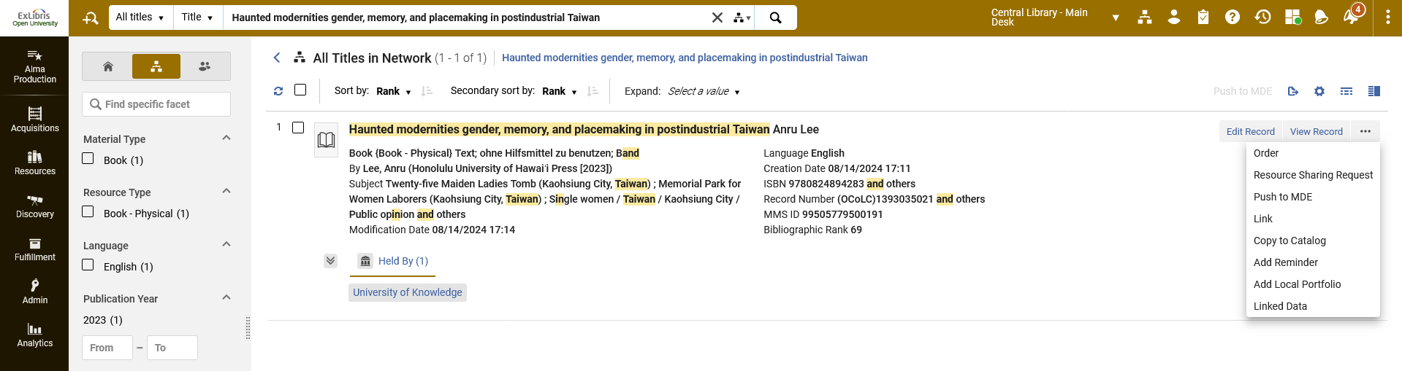
Linking from Network Zone to My Institution
We can add inventory in our Member Institution for this record by clicking “order" and then creating an order which has inventory (last time we clicked “Edit Record".
We will click "Order"

Slide 36
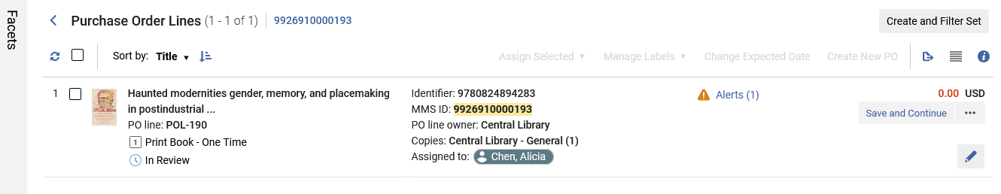
Linking from Network Zone to My Institution
We create an order which includes inventory.

Slide 37
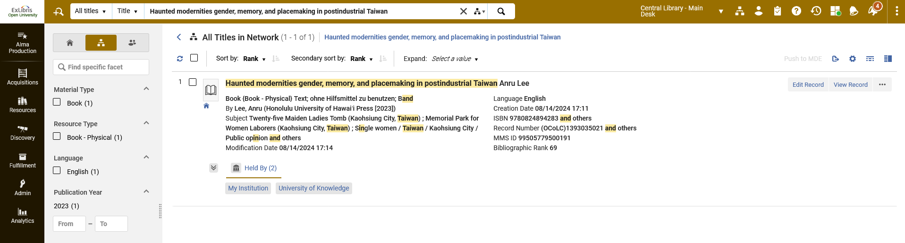
Linking from Network Zone to My Institution
Now title "Haunted modernities gender, memory, and placemaking in postindustrial Taiwan" does have inventory in my institution.

Slide 38
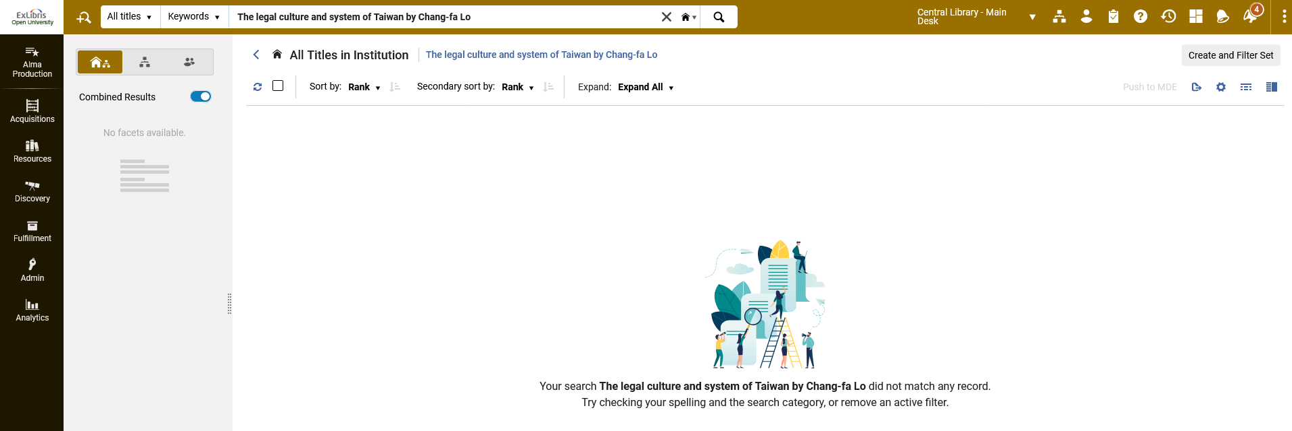
Linking from Network Zone to My Institution
We will now see how is also possible to link from the Member Institution to the Network Zone record without adding inventory.
We are in Member Institution "Open University" and in our institution we do not have "The legal culture and system of Taiwan by Chang-fa Lo"

Slide 39
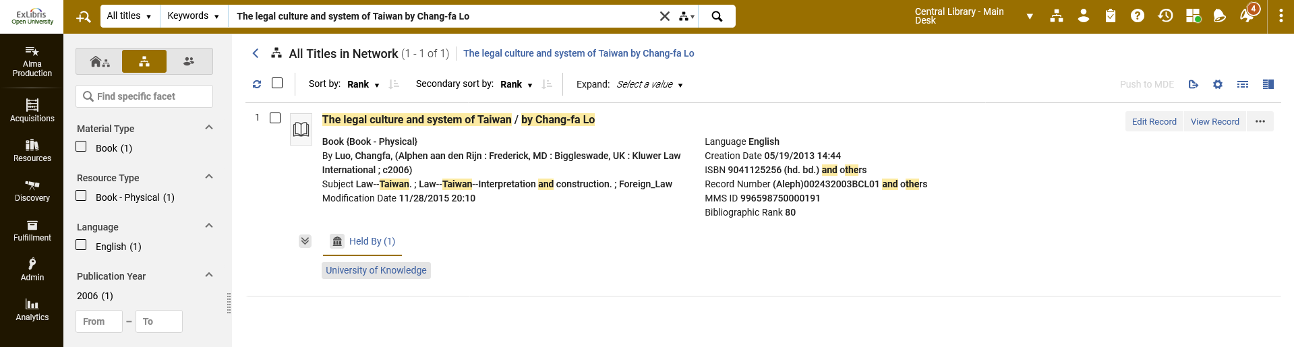
Linking from Network Zone to My Institution
Title "The legal culture and system of Taiwan by Chang-fa Lo" does exist in the Network Zone and is Held By Member Institution "University of Knowledge"

Slide 40
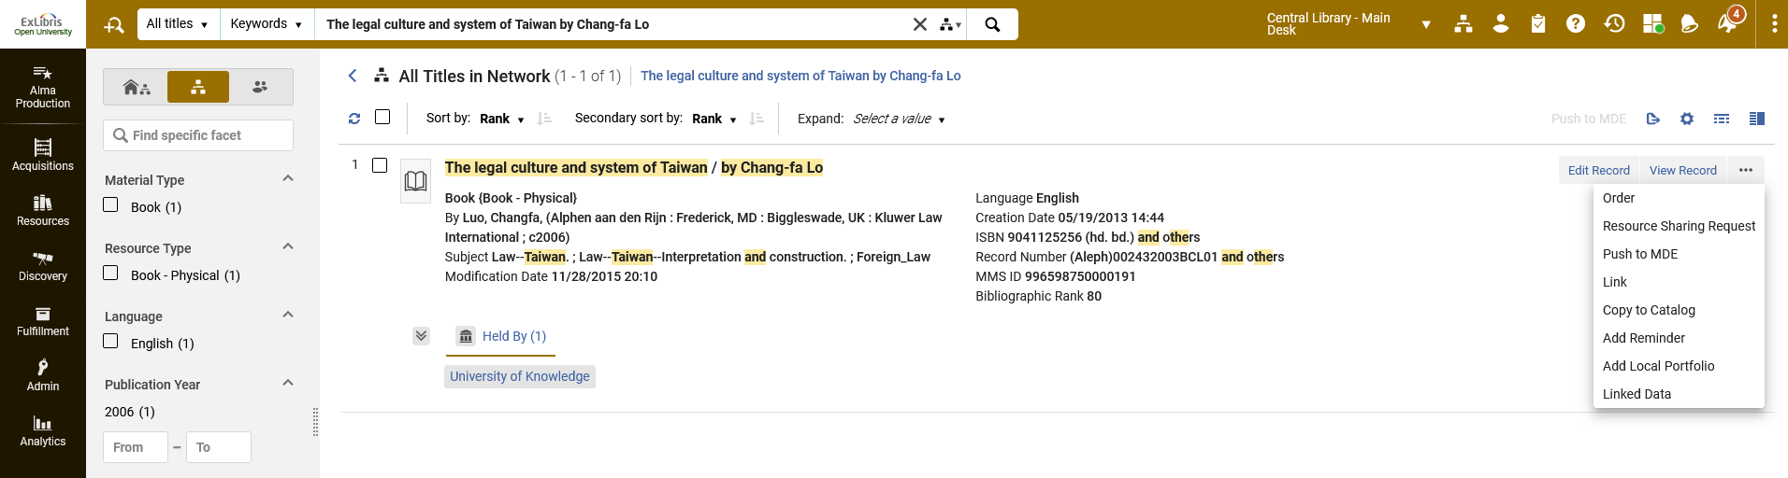
Linking from Network Zone to My Institution
From the Network Zone search of the member institution the action items include an option "Link"
We will click "Link"

Slide 41
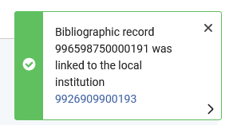
Linking from Network Zone to My Institution
After clicking "Link" we get this message:

Slide 42
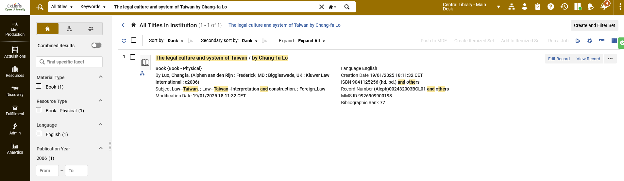
Linking from Network Zone to My Institution
Now when we are in Member Institution "Open University" we do have title "The legal culture and system of Taiwan", but with no inventory
We also have the icon "Show the bibliographic record in the network"

Slide 43
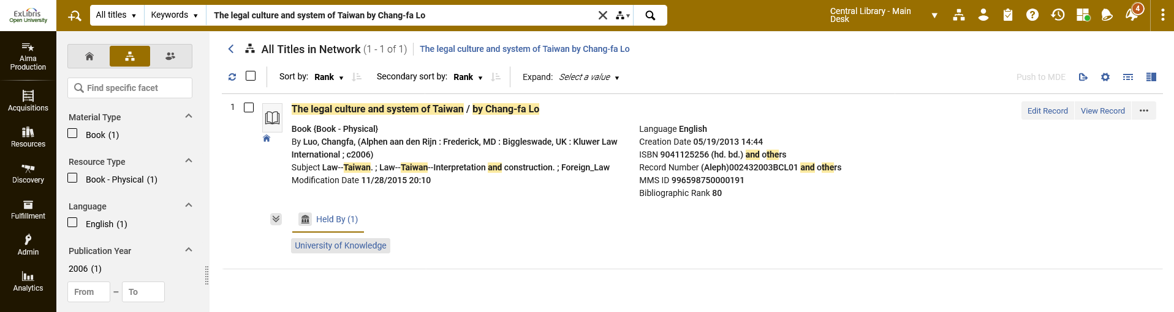
Linking from Network Zone to My Institution
From the network we have the icon "Click to view record in institution", but the "Held By" does not show inventory for "My Institution".

Slide 44
Linking a record from the Member Institution to the Network Zone.

Slide 45
Linking a record from the Member Institution to the Network Zone.
It is also possible to link a record from the Member Institution to the Network Zone.
On the next two slides we see that title "Travel guide Taiwan with introduction by Alicia Chen" is in the Member Institution "Open University" but not in the Network Zone.

Slide 46
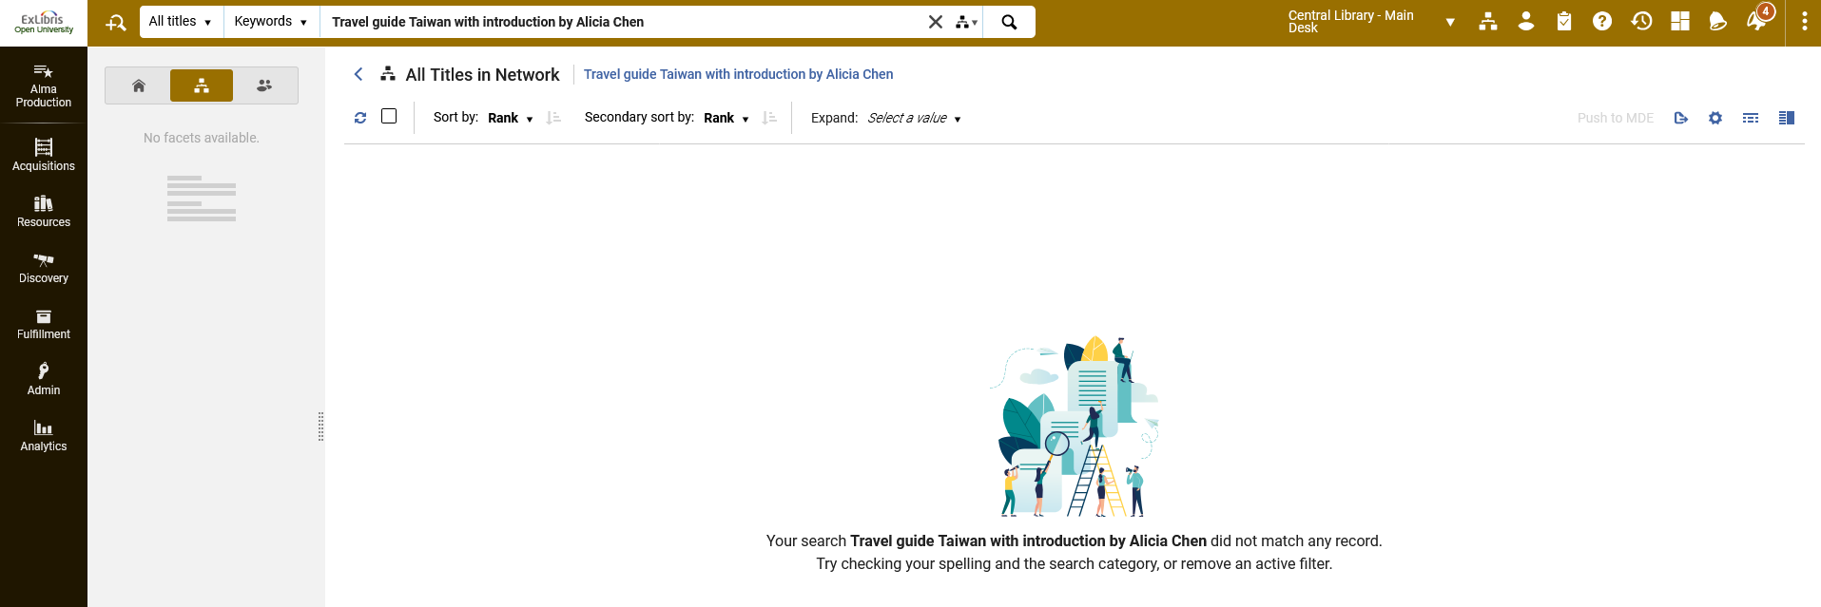
Linking a record from the Member Institution to the Network Zone.
“Travel guide Taiwan with introduction by Alicia Chen” is not in the Network Zone

Slide 47
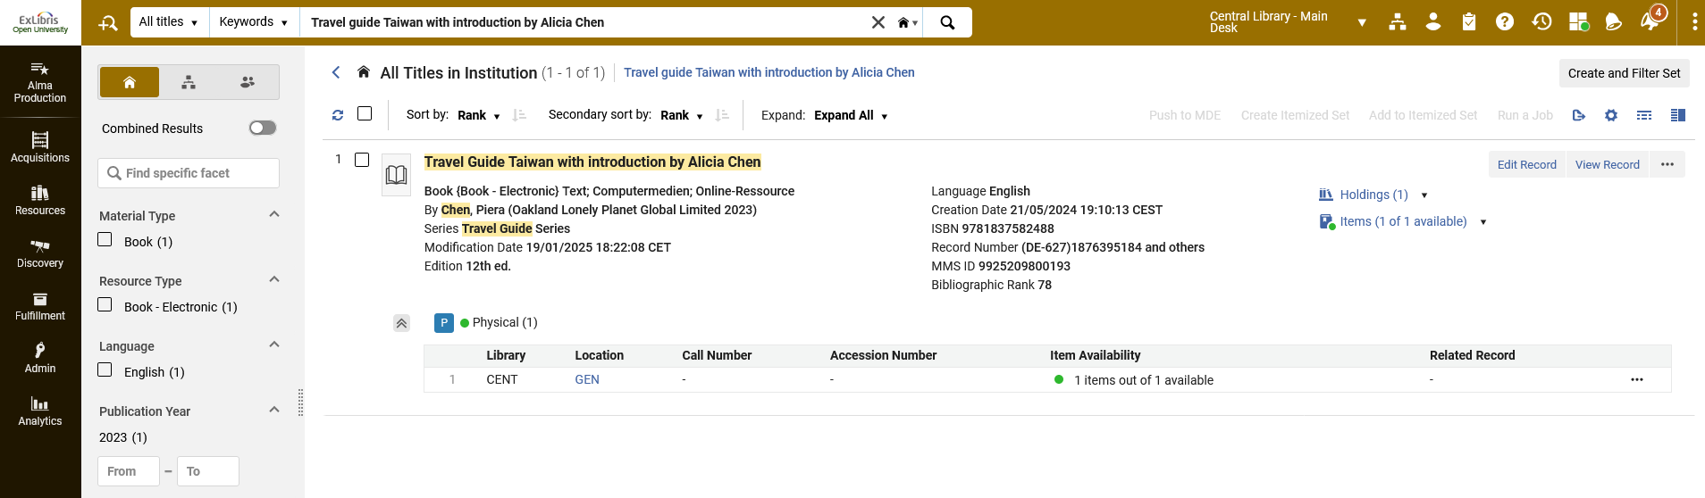
Linking a record from the Member Institution to the Network Zone.
“Travel guide Taiwan with introduction by Alicia Chen” is in the member institution not linked to the Network Zone

Slide 48
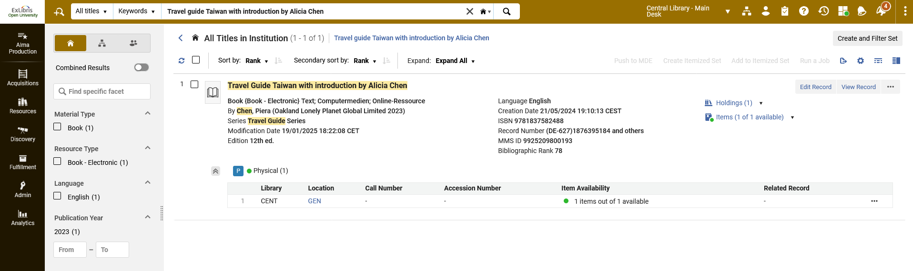
Linking a record from the Member Institution to the Network Zone.
From within member institution “Open University” we will edit the record which is not linked to the Network Zone

Slide 49
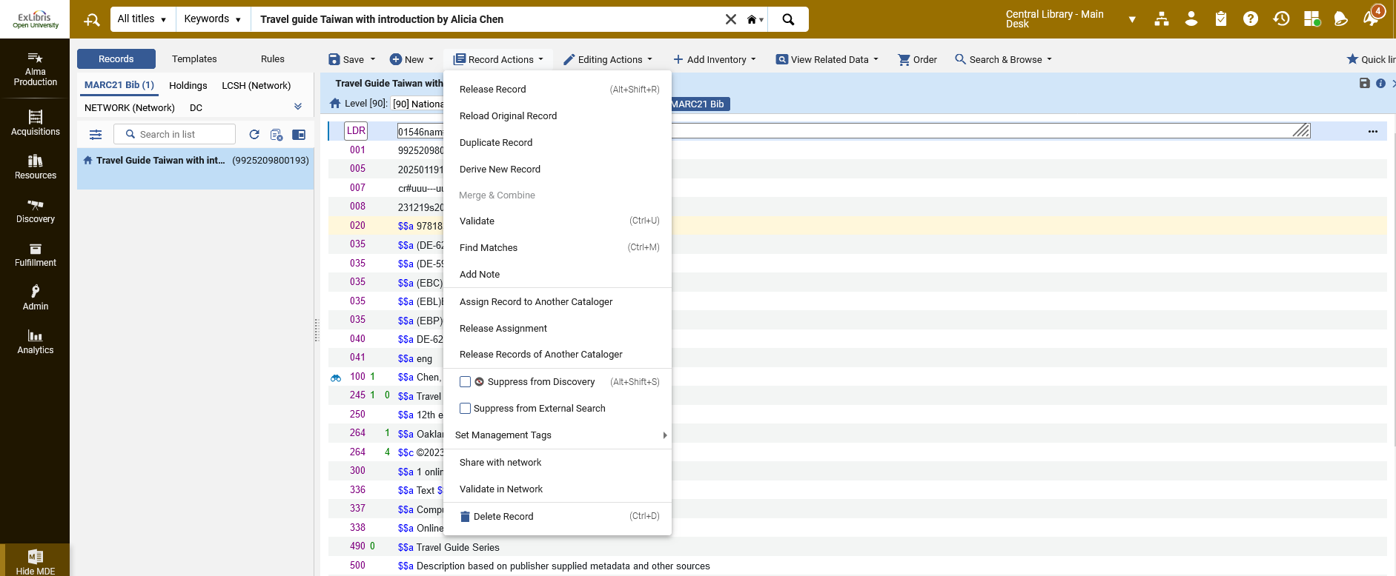
Linking a record from the Member Institution to the Network Zone.
We then choose "Record Actions > Share with network"

Slide 50
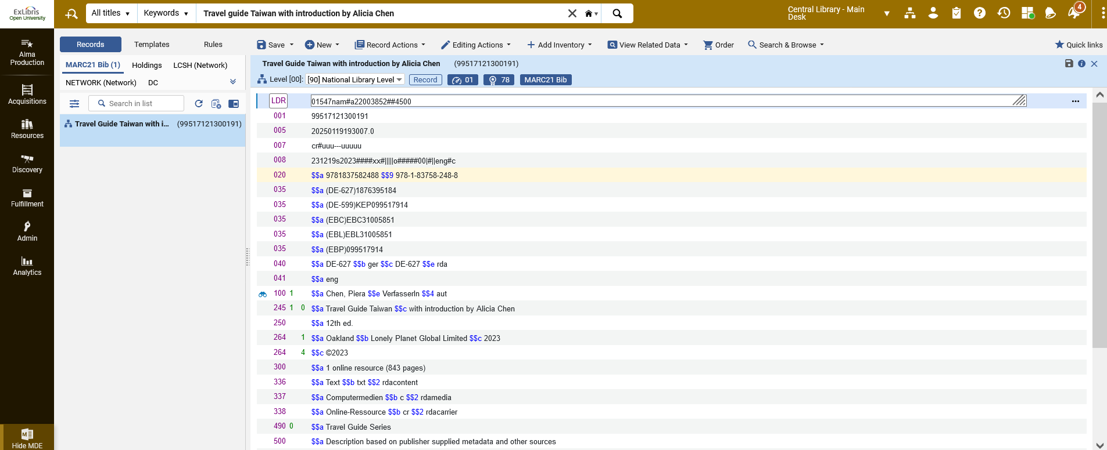
Linking a record from the Member Institution to the Network Zone.
Now the record is shared with the Network Zone

Slide 51

Linking a record from the Member Institution to the Network Zone.
Now the record is shared with the Network Zone

Slide 52
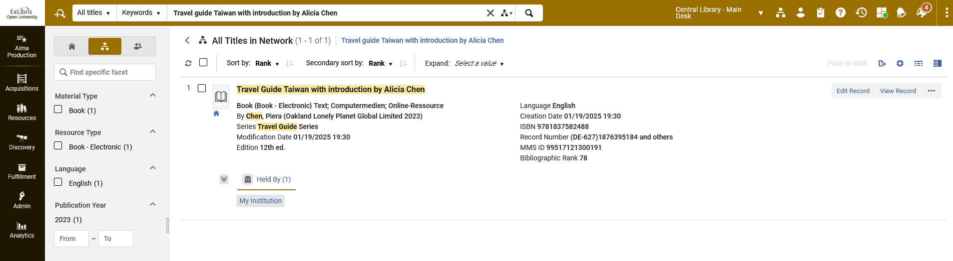
Linking a record from the Member Institution to the Network Zone.
Here is the record in the Network Zone search scope

Slide 53
Primo search in Member Institution and Network Zone - configuration

Slide 54
Primo search in Member Institution and Network Zone - configuration
In addition to the explanation here it may also be useful to see How to create a search profile slot in Primo VE.pptx
From within a Primo View of a member institution it is possible to search records
  From the member institution
  From the consortium
  From the Central Discovery Index
  Any combination of the above

Slide 55
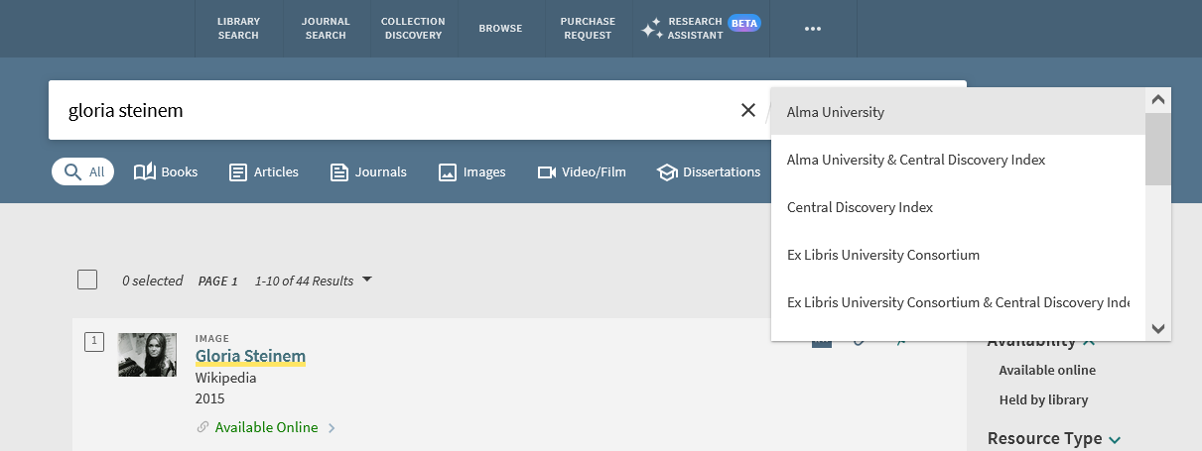
Primo search in Member Institution and Network Zone - configuration
Here, for example, we see the search profile slots for the default Primo view for member institution Alma University.
The member institution
The member institution and the Central Discovery Index
The Central Discovery Index
The consortium
The consortium and the Central Discovery Index

Slide 56
Primo search in Member Institution and Network Zone - configuration
The search profile slots which we saw are at defined at:
  Configuration > Discovery > Display Configuration > Configure Views > Edit View > “Search Profiles Slots” tab
  Configuration > Discovery > Search Configuration > Search Profiles

Slide 57
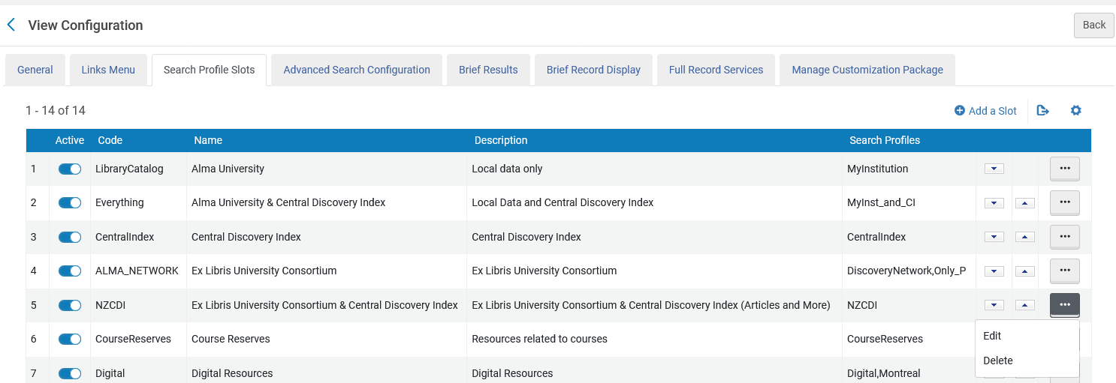
Primo search in Member Institution and Network Zone - configuration
We will now look at the configuration for search Profile Slot “Ex Libris University Consortium & Central Discovery Index” for member institution “Alma University”
We ate at Configuration > Discovery > Display Configuration > Configure Views > Edit View > “Search Profiles Slots” tab

Slide 58
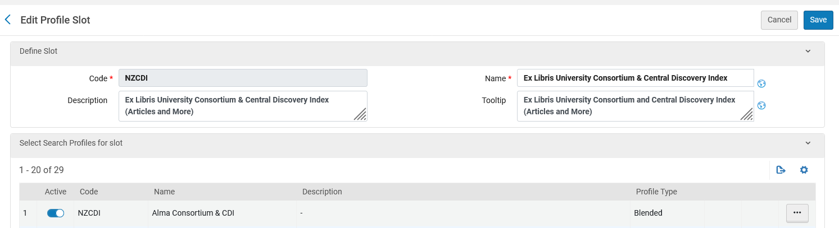
Primo search in Member Institution and Network Zone - configuration
We see that the search profile slot “Ex Libris University Consortium & Central Discovery Index” has one active “Search Profile” and it is code “NZCDI” named “Alma Consortium & CDI”.

Slide 59
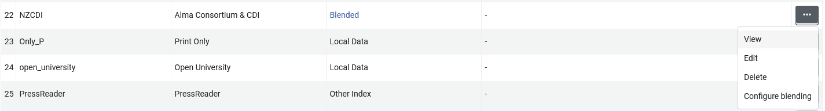
Primo search in Member Institution and Network Zone - configuration
We will now look at the search profile code “NZCDI” name “Alma Consortium & CDI” at Configuration > Discovery > Search Configuration > Search Profiles

Slide 60
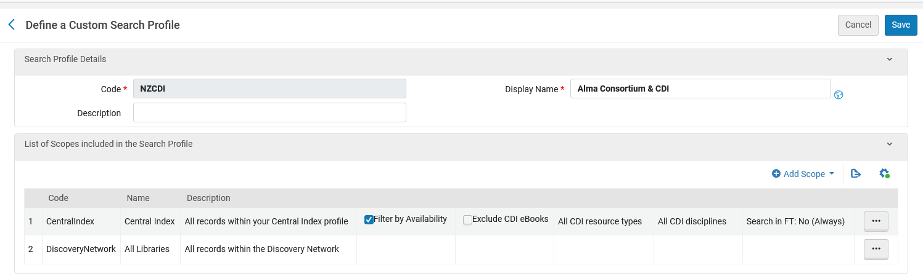
Primo search in Member Institution and Network Zone - configuration
The search profile code “NZCDI” name “Alma Consortium & CDI” uses scopes:
  Code “CentralIndex” name “Central Index”
  Code “DiscoveryNetwork” name “All Libraries”

Slide 61
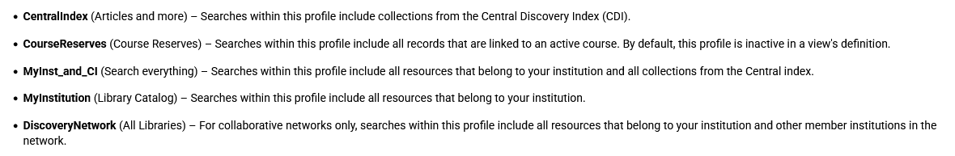
Primo search in Member Institution and Network Zone - configuration
As described at Configuring Search Profiles for Primo VE
The search profile code “Central Index” includes “collections from the Central Discovery Index (CDI)”
The search profile Code “DiscoveryNetwork” includes “all resources that belong to your institution and other member institutions in the network”.

Slide 62
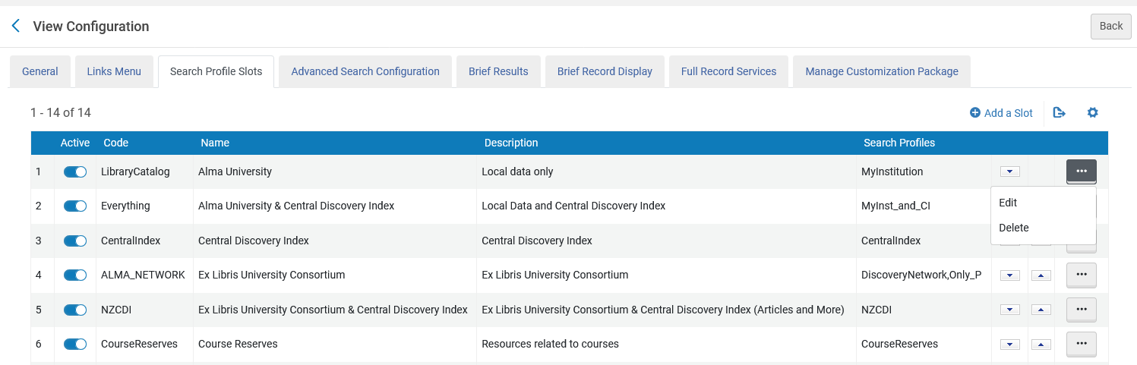
Primo search in Member Institution and Network Zone - configuration
We will now look at the configuration for search Profile Slot “Alma University” for member institution “Alma University”

Slide 63
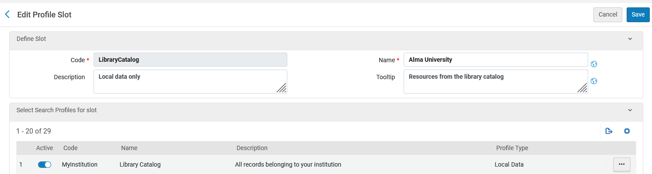
Primo search in Member Institution and Network Zone - configuration
We see that the search profile slot “Alma University” has one active “Search Profile” and it is code “MyInstitution” named “Library Catalog”.

Slide 64
Primo search in Member Institution and Network Zone - configuration
We will now look at the search profile code “MyInstitution” name “Library Catalog” at Configuration > Discovery > Search Configuration > Search Profiles

Slide 65
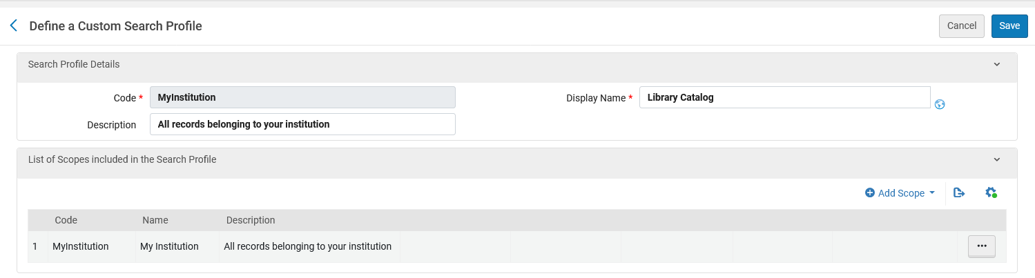
Primo search in Member Institution and Network Zone - configuration
The search profile code “MyInstitution” name “Library Catalog” uses one scope:
  Code “MyInstitution” name “My Institution”

Slide 66
Primo search in Member Institution and Network Zone - configuration
As described at Configuring Search Profiles for Primo VE
The search profile Code “MyInstitution” includes “all resources that belong to your institution”.

Slide 67
Primo search in Member Institution and Network Zone - example

Slide 68
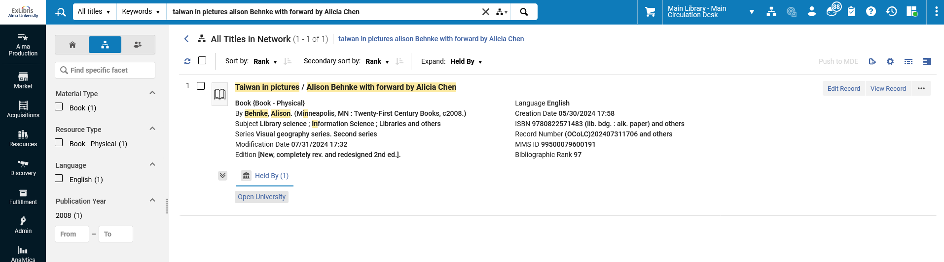
Primo search in Member Institution and Network Zone - example
We know from doing an Alma search that title “Taiwan in pictures / Alison Behnke with forward by Alicia Chen” is held only by Open University

Slide 69
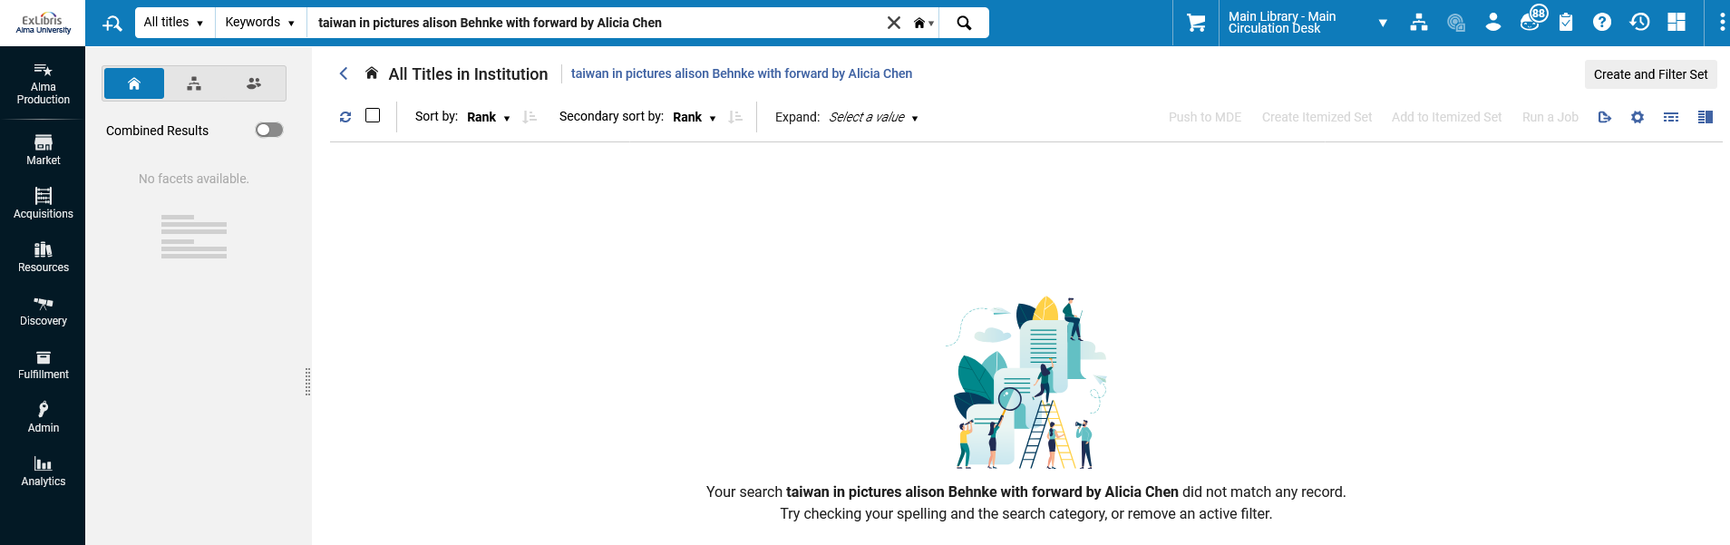
Primo search in Member Institution and Network Zone - example
We know from doing an Alma search that title “Taiwan in pictures / Alison Behnke with forward by Alicia Chen” is not held by Alma University

Slide 70
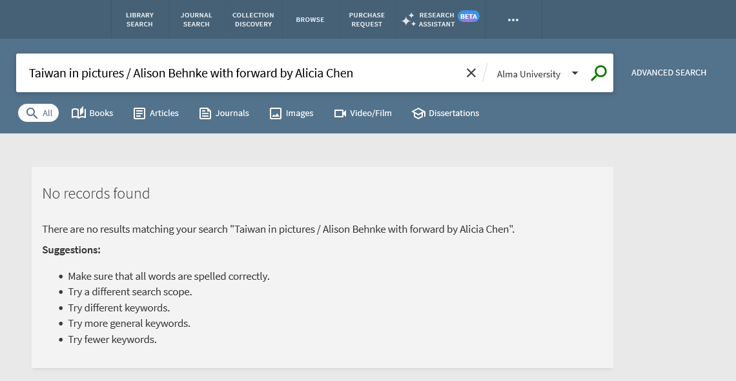
Primo search in Member Institution and Network Zone - example
In Primo, from member institution Alma University, if we search for “Taiwan in pictures / Alison Behnke with forward by Alicia Chen” in search profile slot “Alma University” we get no results

Slide 71
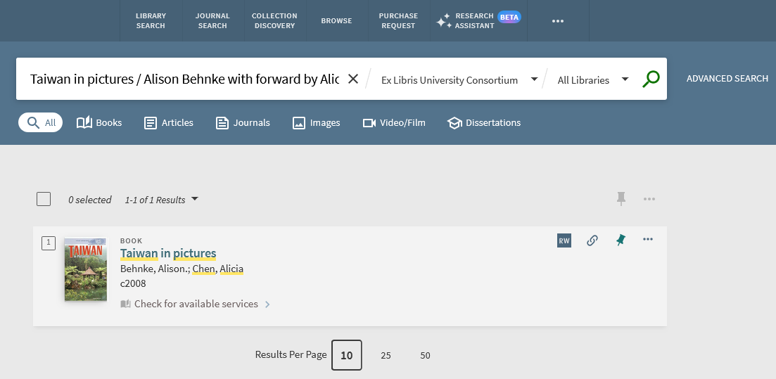
Primo search in Member Institution and Network Zone - example
In Primo, from member institution Alma University, if we search for “Taiwan in pictures / Alison Behnke with forward by Alicia Chen” in search profile slot “Ex Libris University” then we retrieve the record from Open University
We will now click “Check for available services”

Slide 72
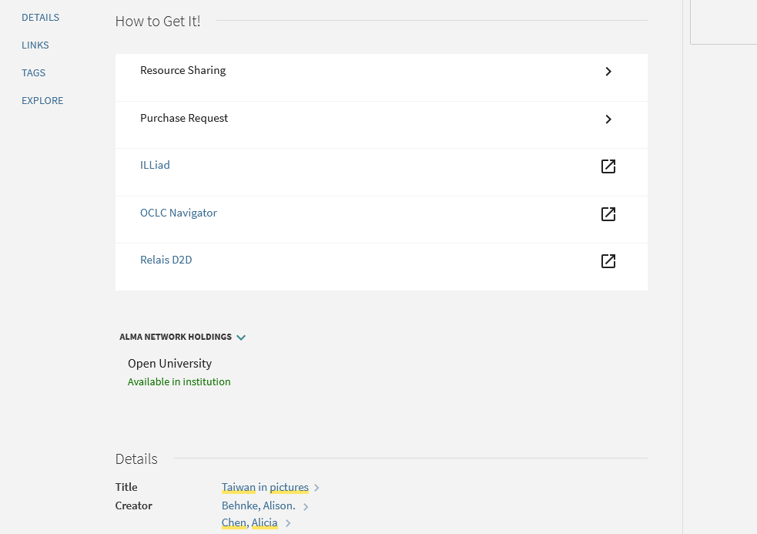
Primo search in Member Institution and Network Zone - example
We see that the record is from Open University and (depending on other configuration) various services are available
The “Alma Network Holdings” shows that it is available at member institution Open University

Slide 73
Primo search in Member Institution and Network Zone - example
Thus, we have seen that an end user in Primo can search (among other options)
  His or her own institution
  The entire consortium
If he or she searches the entire consortium then it is possible to retrieve records that are in other member institutions.

